Slide 1
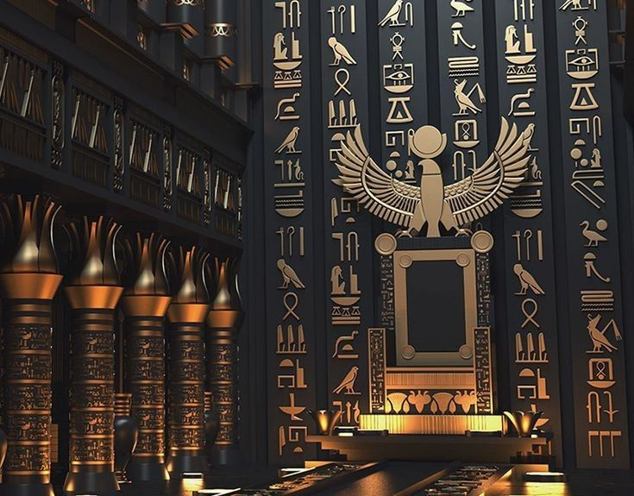
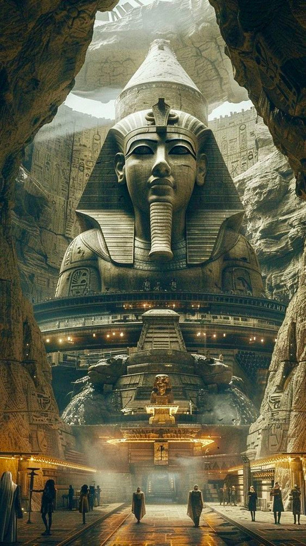
TOUR SCAN
1

Slide 2
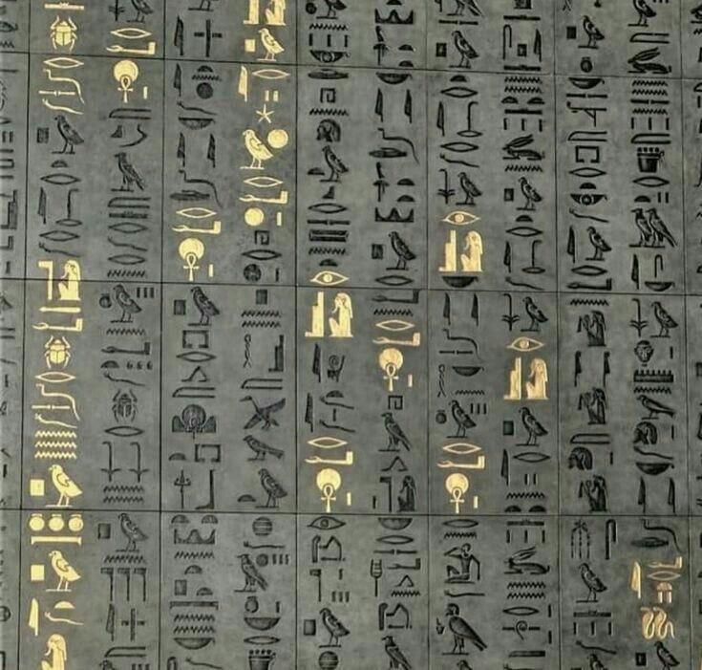
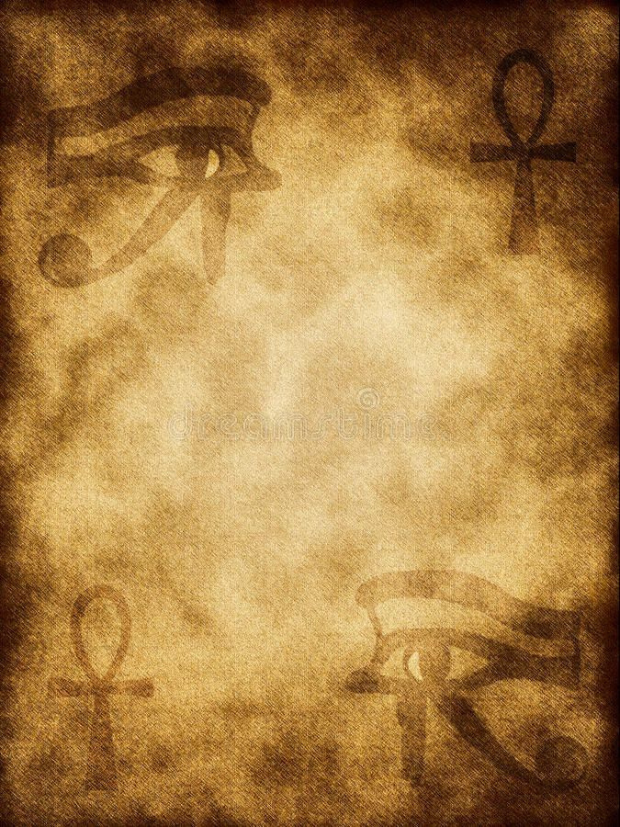
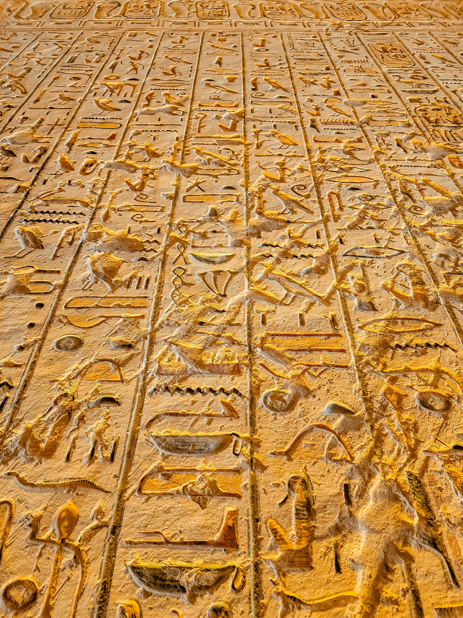
Tour Scan
Under Supervision of
Dr .Yasser Abdelftattah
Eng.Salma montaser
2

Slide 3
Member
Mohamed Mamdouh Abdelbary 2101182
Mostafa kamel hussien 2101312
Saber sayed ahmed 2101525
Kholoud abdelmaugoud sabry 2100881
Dina Sadiq Badr 2100601
Esraa Hossien abdelhafez 2100647
Mai Ismail omar 2100121
3

Slide 4
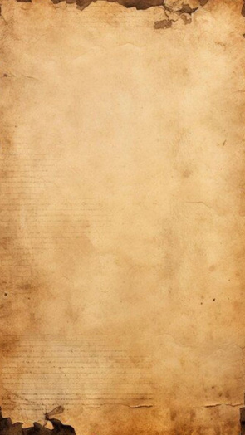
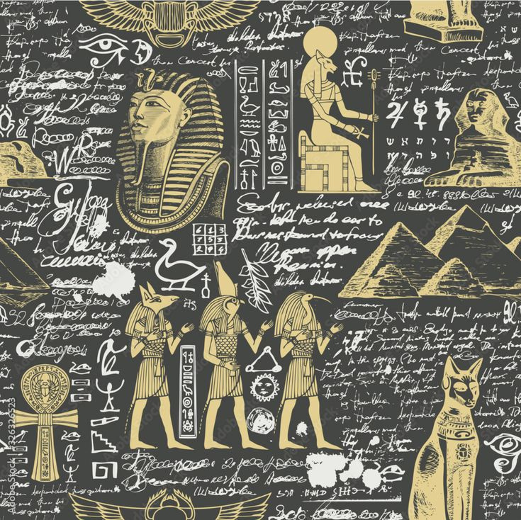

outlines
Problem
Statement
Related
Work
introduction
Objective
&
Approach
System
Diagram
Features
4

Slide 5
outlines
System
Methodology
Proposed Model
Dataset
Future work
Conclusions
Refernces​
5

Slide 6
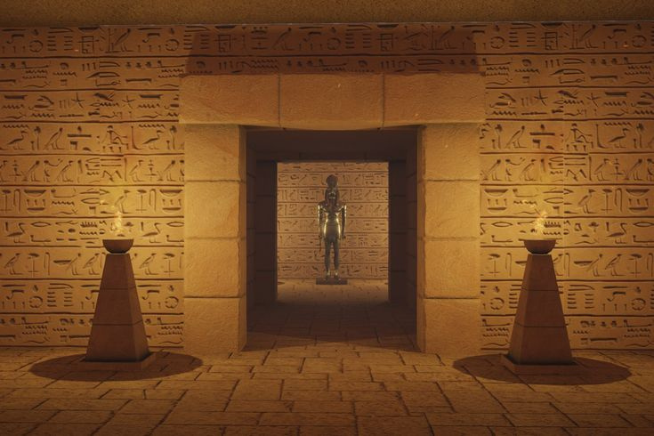
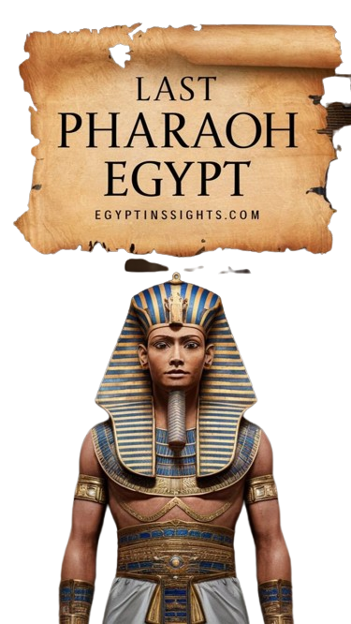
Introduction
6

Slide 7
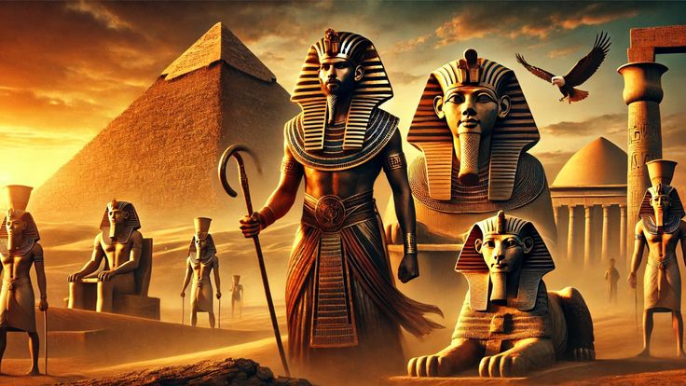
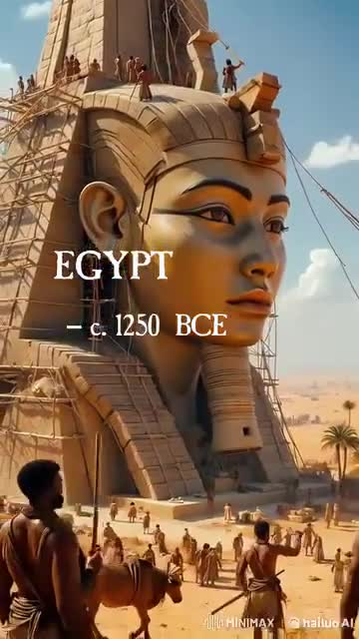
Introduction
Tour Scan:
A mobile application designed to experience tourists visiting the Egyptian Museum. This innovative application acts as a smart tour guide that provides visitors with information about the history of Egypt.
Through the use of artificial intelligence, the application allows users to explore
Detailed information about artifacts, historical insights and interactive content in their native language.
7

Slide 8
Problem
Statement
8

Slide 9
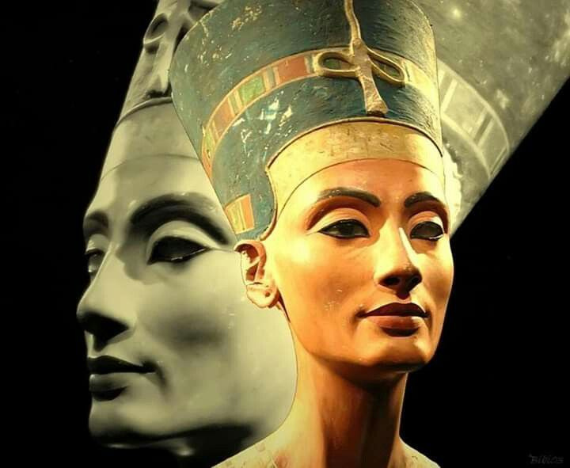
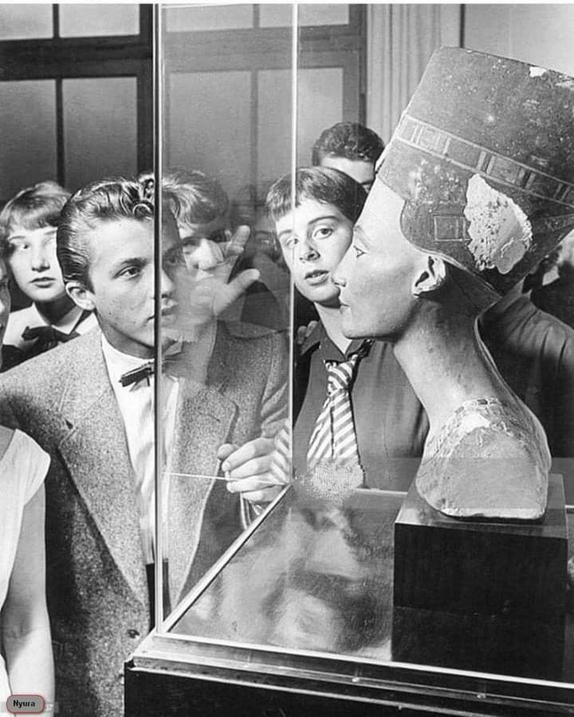
Problem Statement
Problem Statement :
Tourists visiting museums and historical landmarks often face significant challenges in accessing accurate, engaging, and multilingual information about the artifacts and monuments they encounter. Traditional resources such as guidebooks, plaques, or tour guides are often limited, outdated, unavailable, or constrained by language barriers. As a result, visitors—especially non-native speakers or those with accessibility needs—struggle to fully understand and appreciate the cultural and historical significance of these sites.
9

Slide 10
Related
Work
10

Slide 11
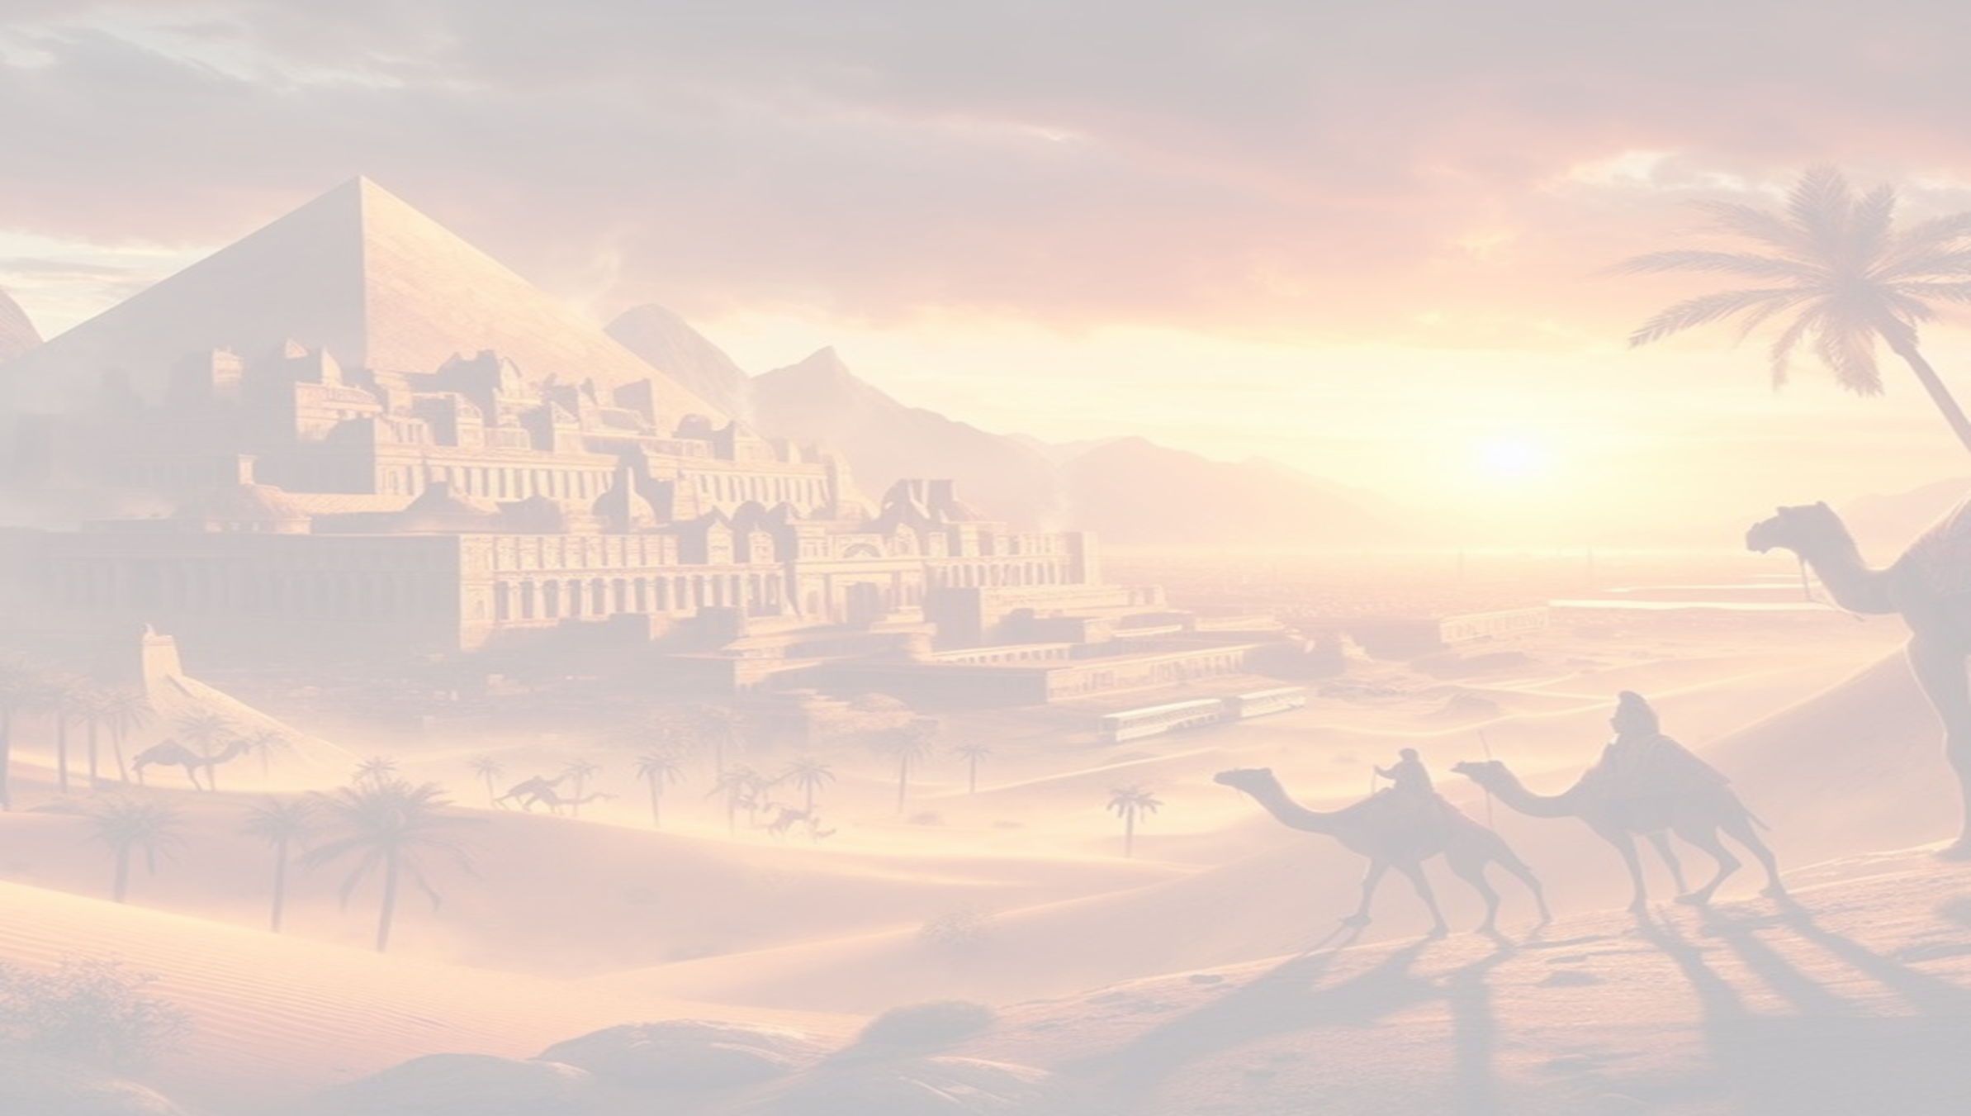


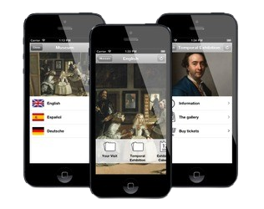
Related Work
mobile smart travelling application for indonesia
Year: 2017
Tourists visiting museums and historical landmarks often face significant challenges in accessing accurate, engaging, and multilingual information about the artifacts and monuments they encounter. Traditional resources such as guidebooks, plaques, or tour guides are often limited, outdated, unavailable, or constrained by language barriers. As a result, visitors—especially non-native speakers or those with accessibility needs—struggle to fully understand and appreciate the cultural and historical significance of these sites.
11

Slide 12


Related Work
Deep learning and internet of things for tourist
Year: 2022
The system uses IoT and deep learning to give personalized travel suggestions based on real-time data like location, weather, and time. This makes travel easier and more enjoyable by providing useful and relevant recommendations.
12

Slide 13
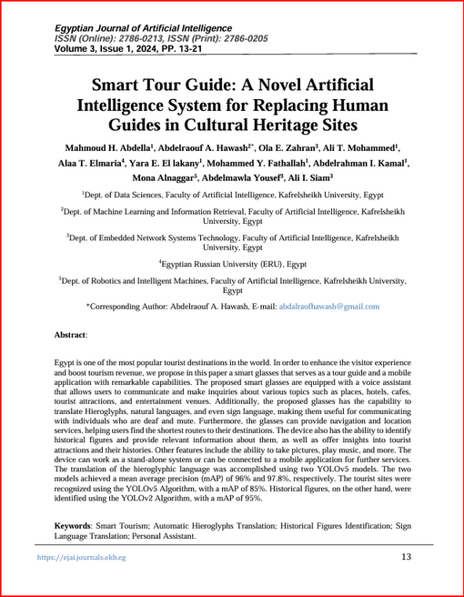
Related Work
Smart Tour Guide
year:2024
The smart system is very important for people with disabilities, as it provides an easier and more inclusive travel experience through landmark and face recognition, hieroglyphic text translation, and support for voice assistants and sign language.
13

Slide 14
Objective & Approach
14

Slide 15
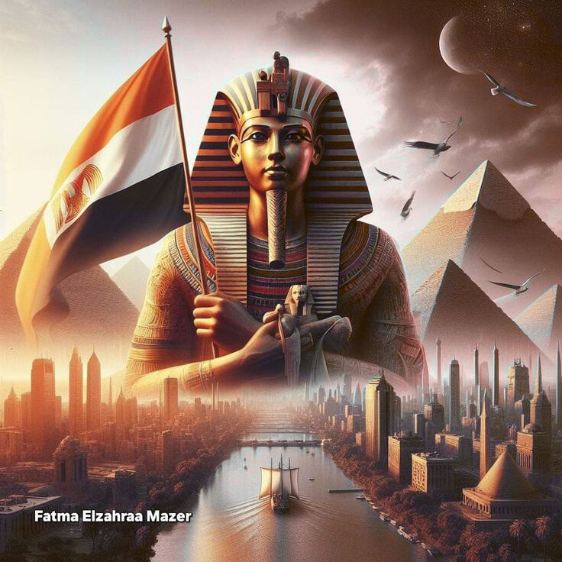
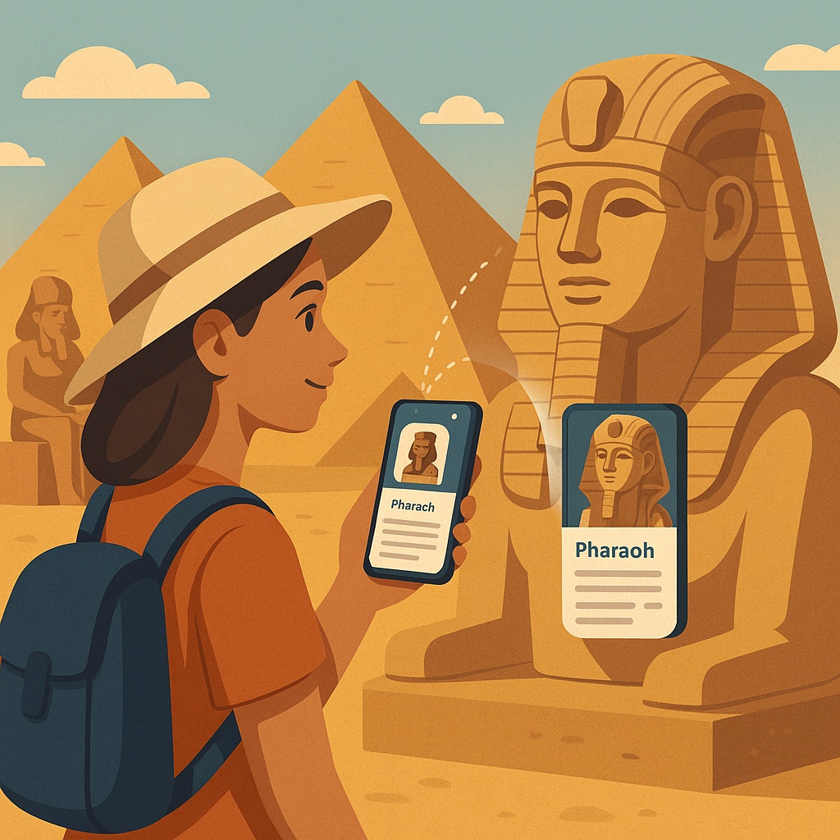
Objective & Approach
Objective:
To develop a smart tour guide app for Egyptian monuments, leveraging Artificial Intelligence to assist tourists in identifying and learning about Egypt's historical artifacts.
15

Slide 16
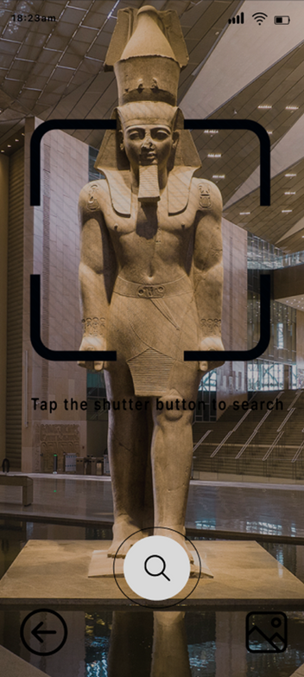
Objective & Approach
Approach:
Artifact Recognition using Convolutional Neural Networks (CNN) allows users to capture an image of any artifact at Egyptian archaeological sites. The app utilizes AI-powered image recognition to analyze the photo, identify the artifact, and provide its background and historical context. It then displays detailed information, including the artifact's name, original location, and its significance in ancient Egyptian culture and rituals.
16

Slide 17
Features
17

Slide 18
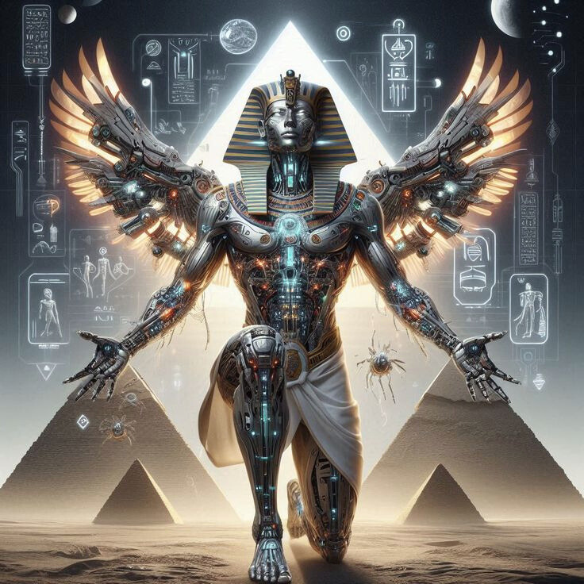
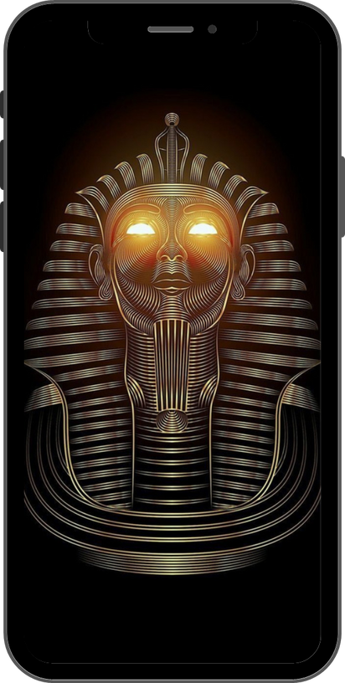

Features
Artifact Recognition with MobileNet:
TourScan leverages MobileNet, a lightweight and efficient Convolutional Neural Network (CNN), to enable real-time image recognition on mobile devices. This model is specifically optimized for mobile environments, allowing artifact recognition to happen on-device without the need for a constant internet connection.
How It Works:
1.Scan with Camera.
2.Image Processing and Recognition.
3.The app displays historical information.
18

Slide 19


Features
Multilingual Support:
Supports English and Arabic languages.
Automatic translation of artifact descriptions based on the selected language.
Text-to-Speech (TTS):
Converts artifact information into speech.
Helps visually impaired users or tourists who prefer audio guidance.
19

Slide 20
System
Diagram
20

Slide 21
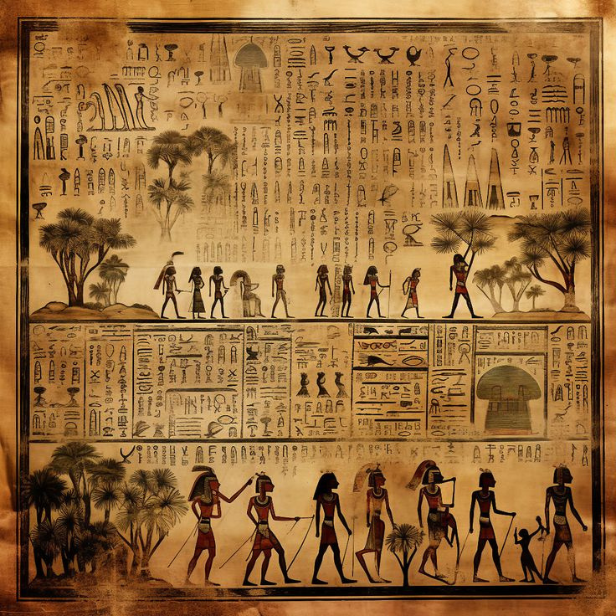
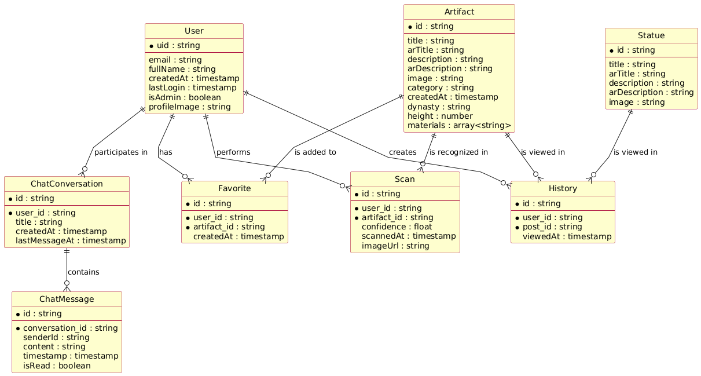
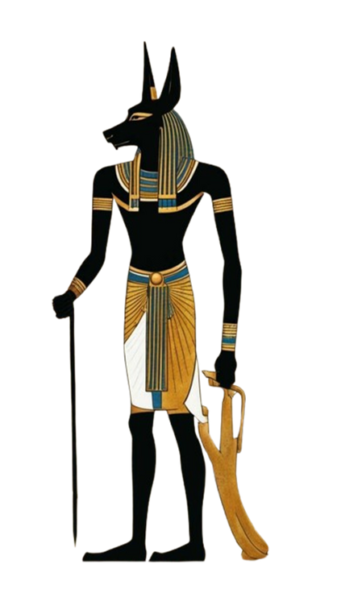
ER Diagram
Figure.1
21

Slide 22
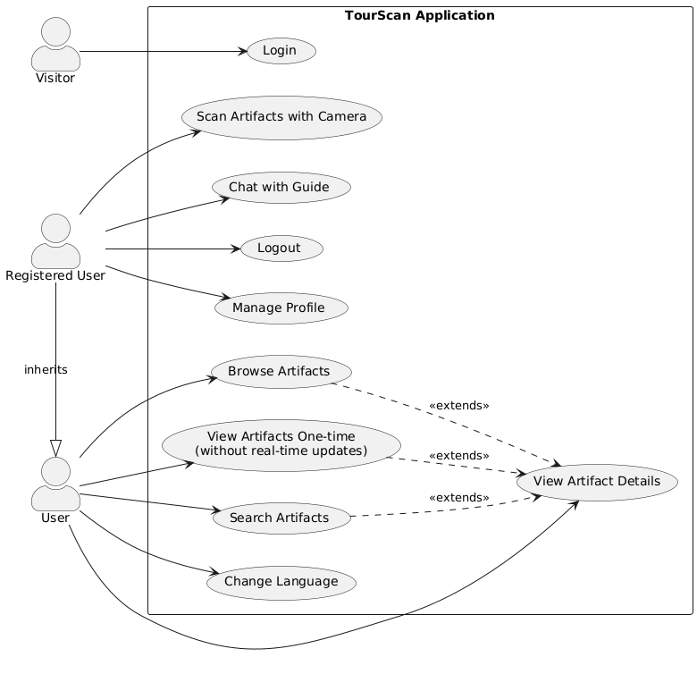
Use Case Diagram
Figure.2
22

Slide 23
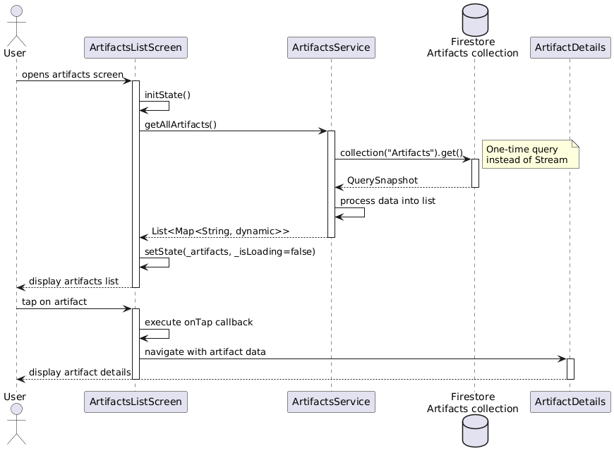
Sequence Diagram
Figure.3
23

Slide 24
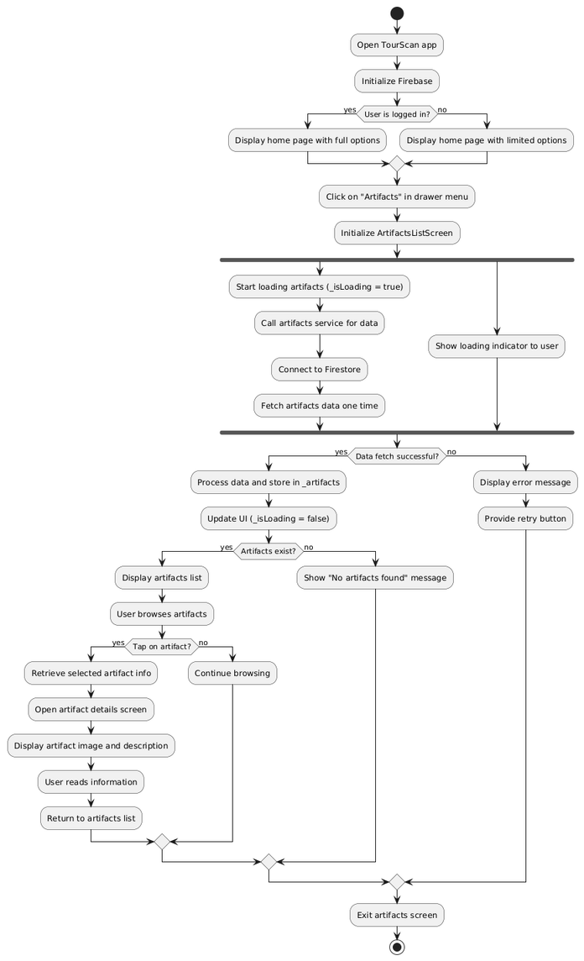
Activity Diagram
Figure.4
24

Slide 25
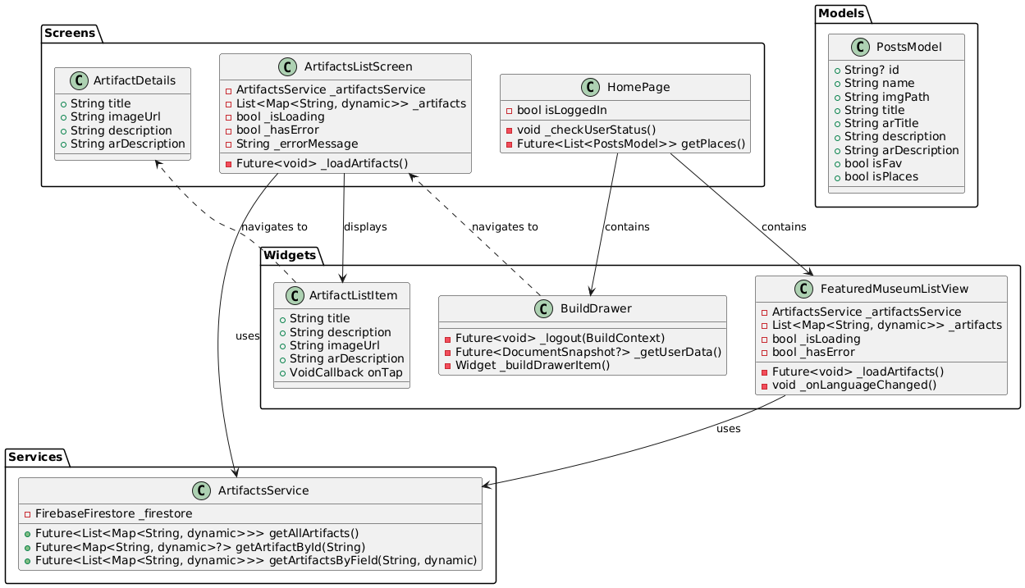
Class Diagram
Figure.5
25

Slide 26
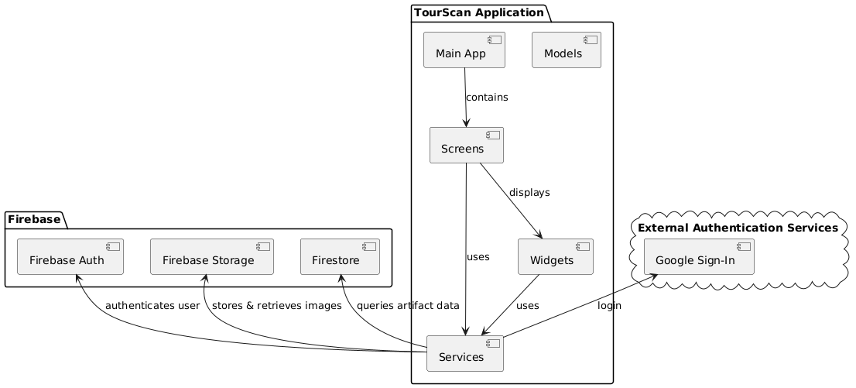
Component Diagram
Figure.6
26

Slide 27
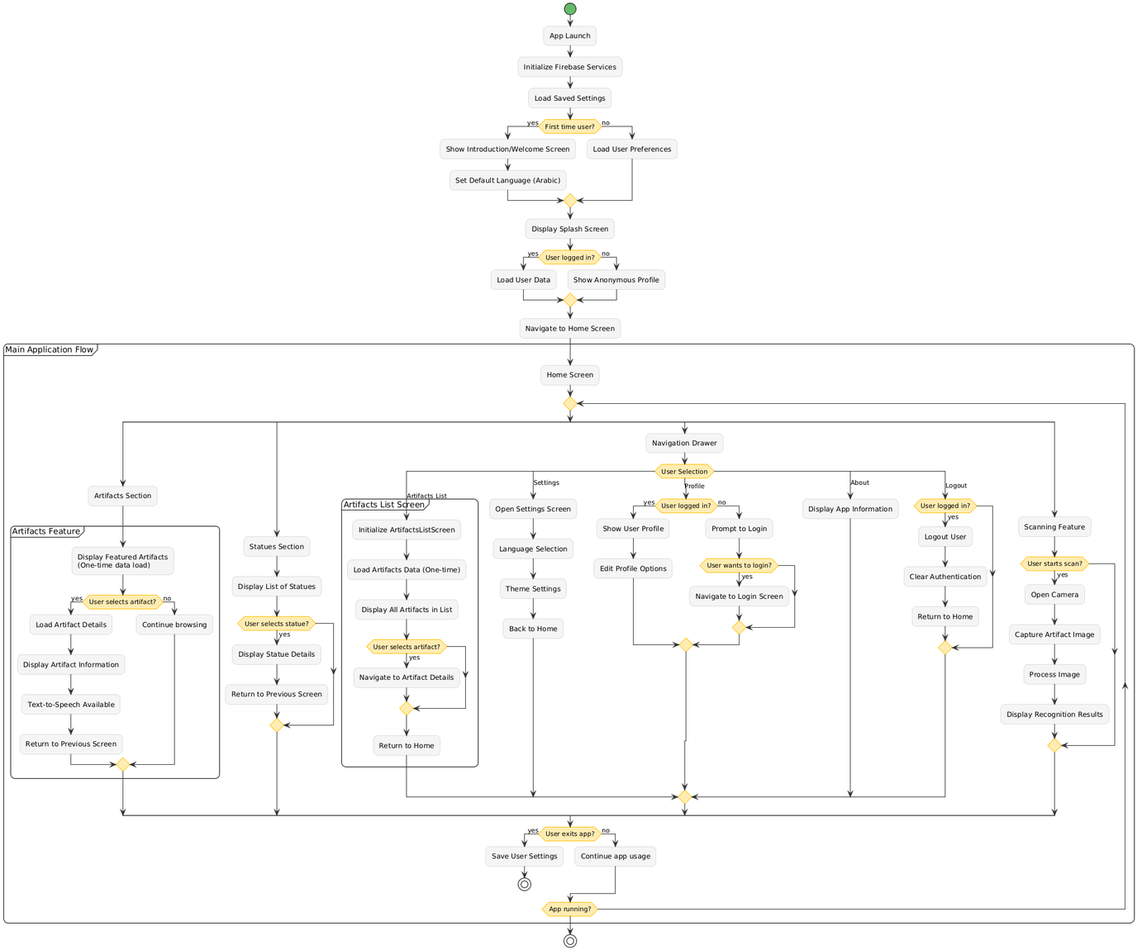
Flowchart Diagram
Figure.7
27

Slide 28
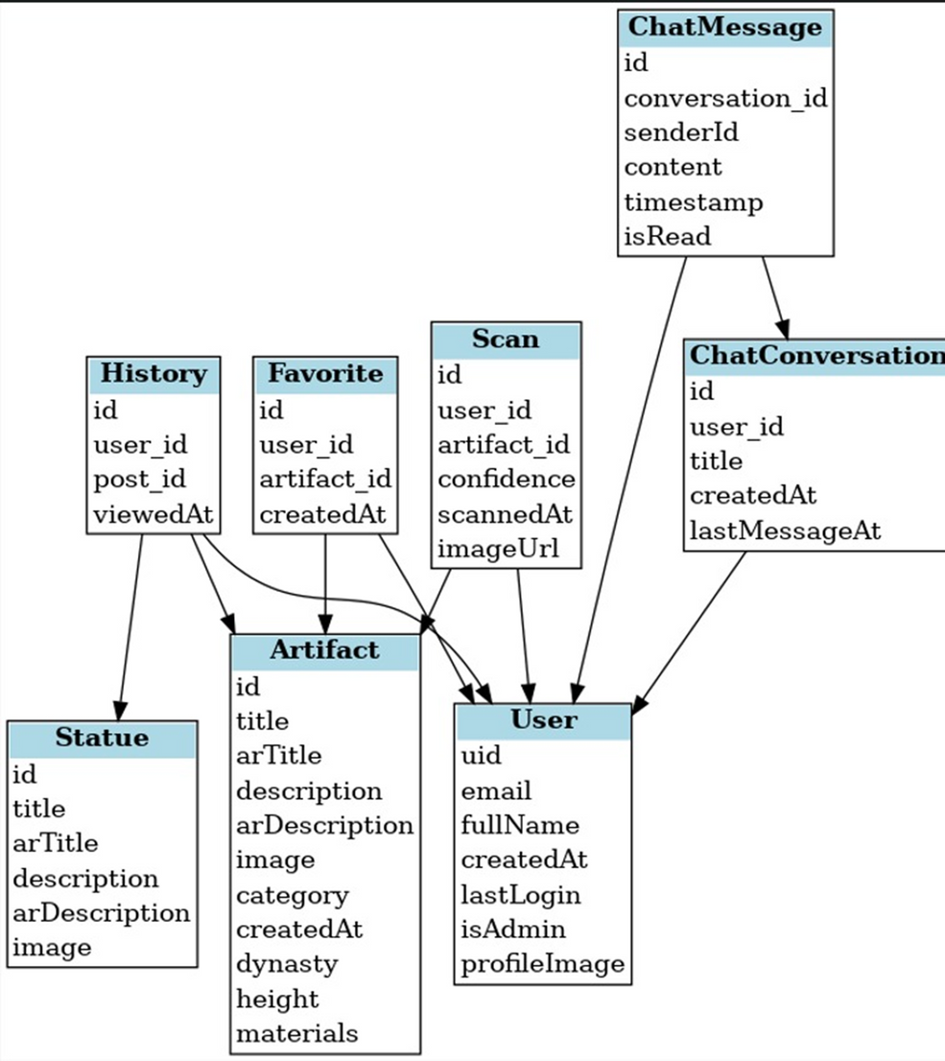
Schema Diagram
Figure.8
28

Slide 29
Dataset
29

Slide 30
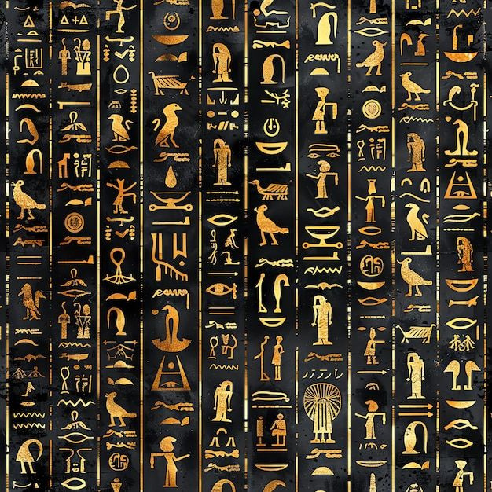

DataSet
1. Overview:
The dataset contains images of various monuments and antiques from the Egyptian Museum, with each class representing a specific artifact.
2. Structure:
Total images: 10,333
Split into:
- Training: 9,822 images
- Testing: 511 images
3. Use Cases:
Assisting tourists in recognizing monuments
Supporting educational and tourism applications
30

Slide 31
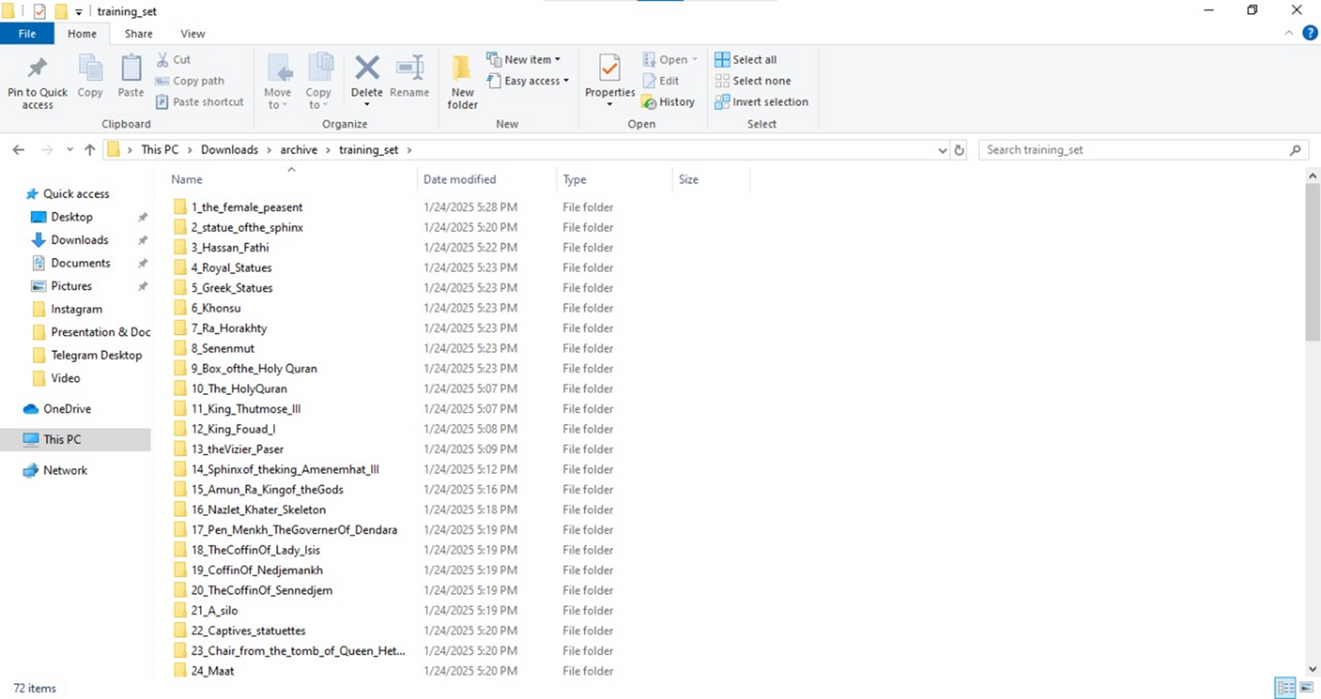
DataSet
Training:
Figure.9
31

Slide 32

DataSet
Testing:
Figure.10
32

Slide 33
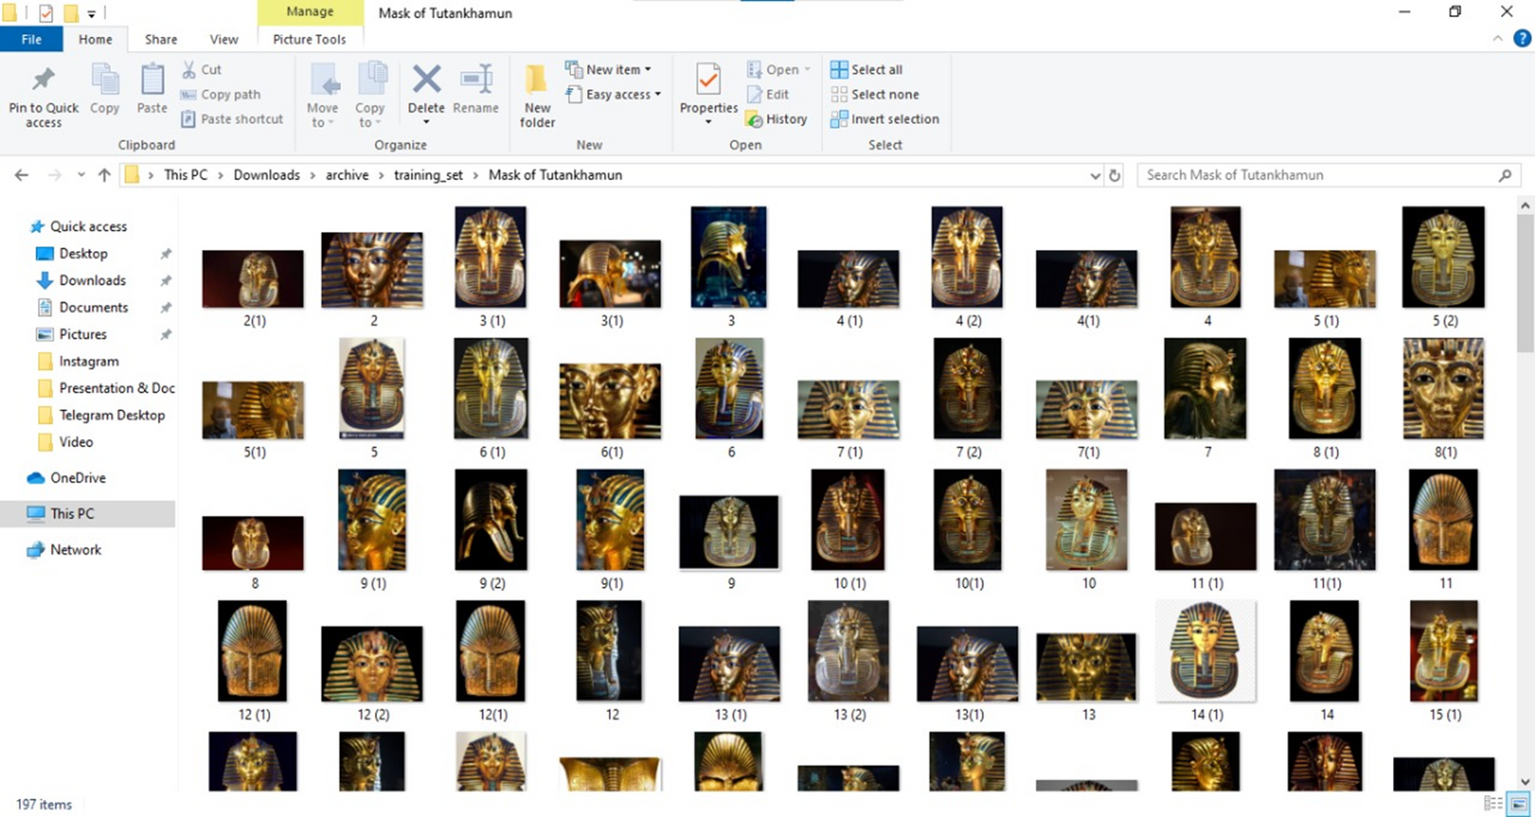
DataSet
Figure.11
33

Slide 34
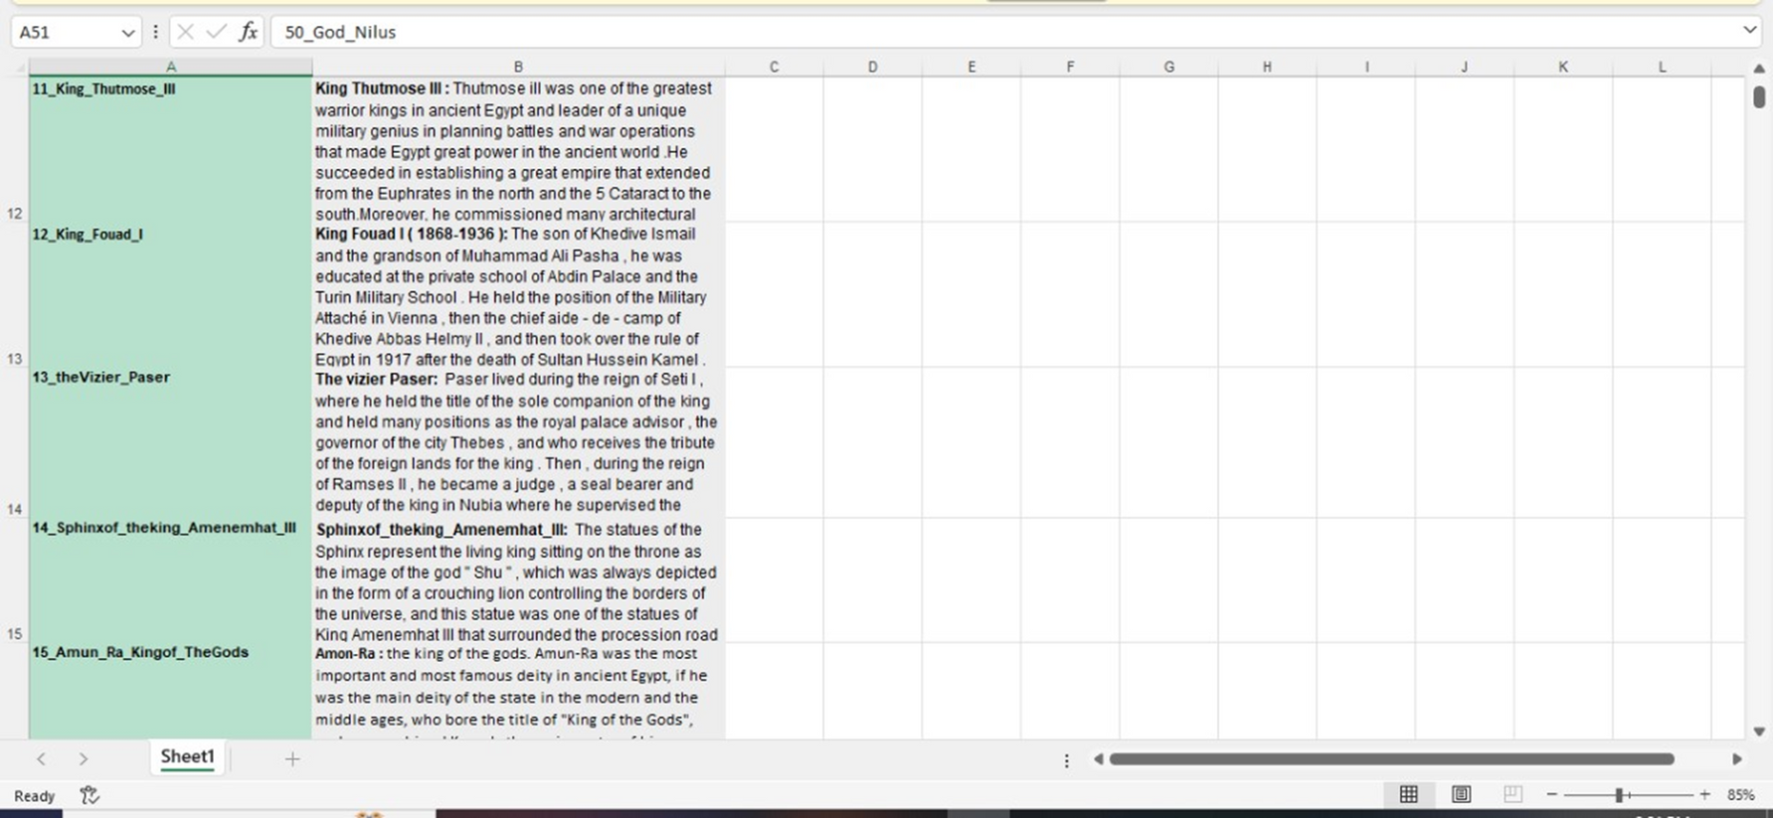
DataSet
Figure.12
34

Slide 35
DataSet
Figure.13
35

Slide 36
System
Methodology
36

Slide 37
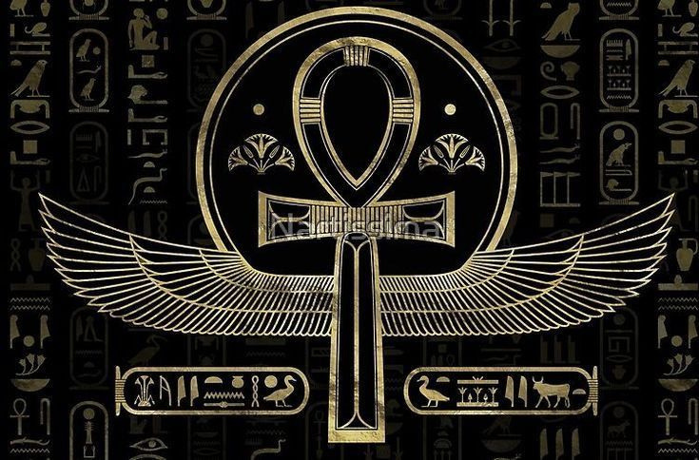
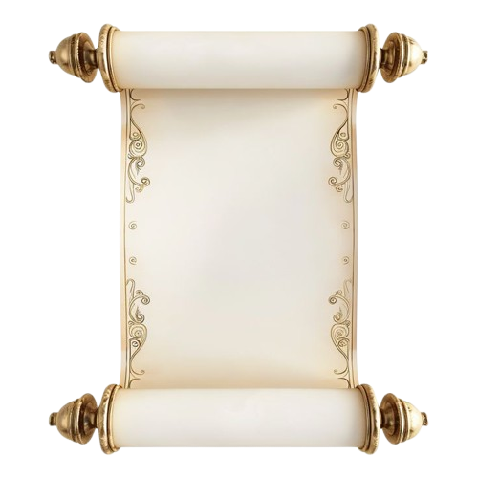
TOOLS
Visual Studio Code
Flutter
Colab
Python​
TenserFlow
FireBase
37

Slide 38
Proposed Model
38

Slide 39
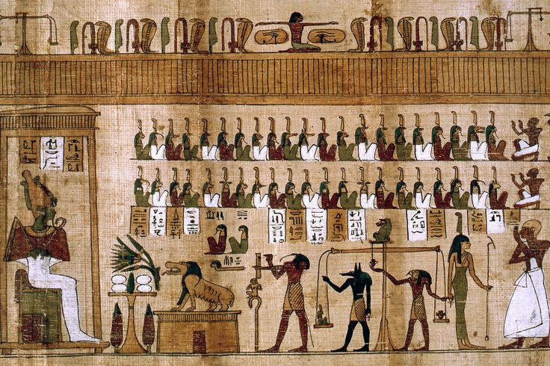
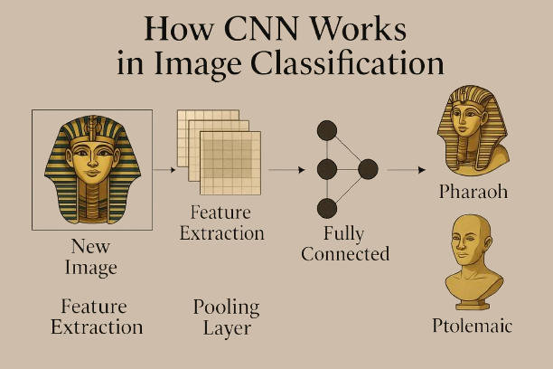
PROPOSED MODEL
How CNN Works in Image Classification:
Feed raw images into the network.
Convolutional layers extract spatial features.
Pooling layers reduce spatial size.
Fully connected layers make predictions.
Output layer classifies the image.
Model Accuracy: 98%
39

Slide 40
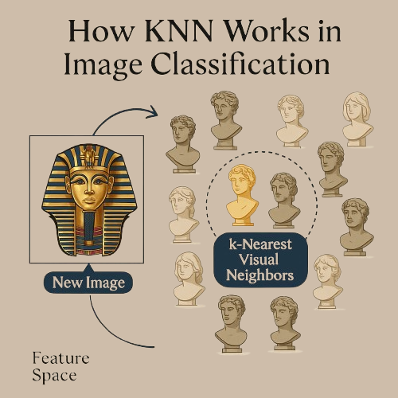
PROPOSED MODEL
How KNN Works in Image Classification:
Convert images into feature vectors.
Choose k (number of neighbors).
Measure distance (e.g., Euclidean) to all training images.
Identify k closest images.
Assign the most frequent label among neighbors.
Model Accuracy: 52%
40

Slide 41
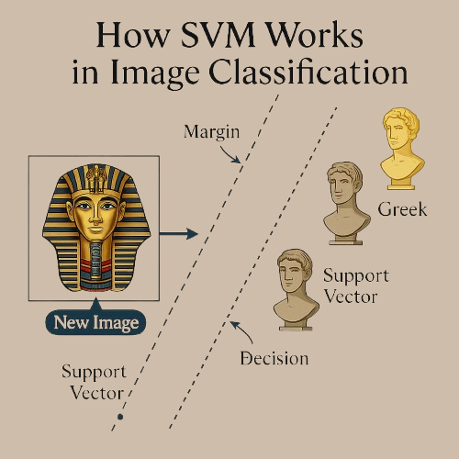
PROPOSED MODEL
How SVM Works in Image Classification:
Extract features from images.
Map features to a high-dimensional space.
Find the optimal hyperplane that separates classes.
Use kernel tricks for non-linear cases.
Model Accuracy: 45%
41

Slide 42
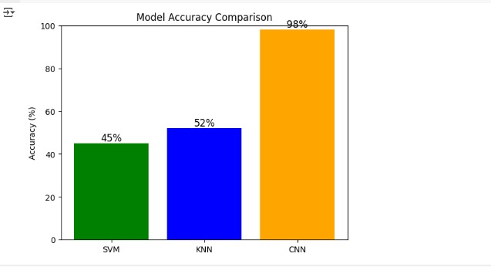
PROPOSED MODEL
Why CNN?
-Highest accuracy in image classification (98%).
Learns features automatically from raw images.
Outperforms KNN (52%) and SVM (45%).
Handles complex visual patterns.
Robust and generalizes well to new data.
Figure.14
42

Slide 43
System Design
43

Slide 44
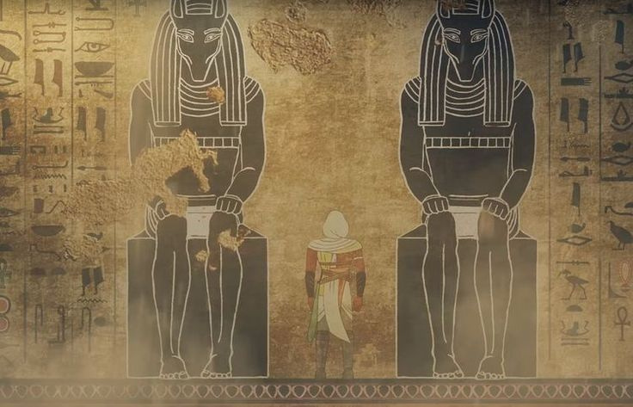
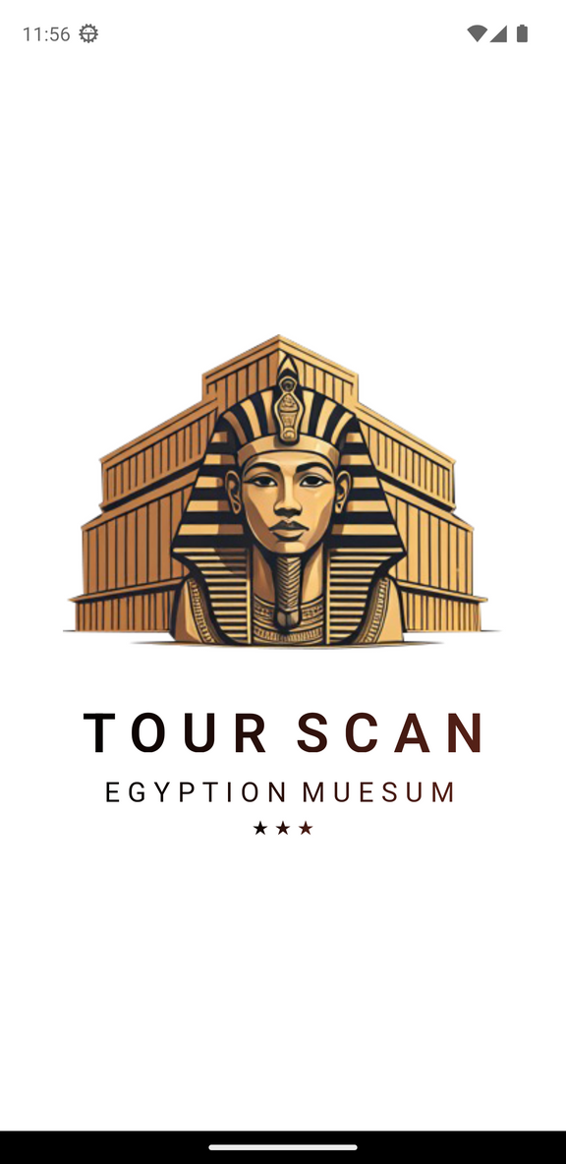
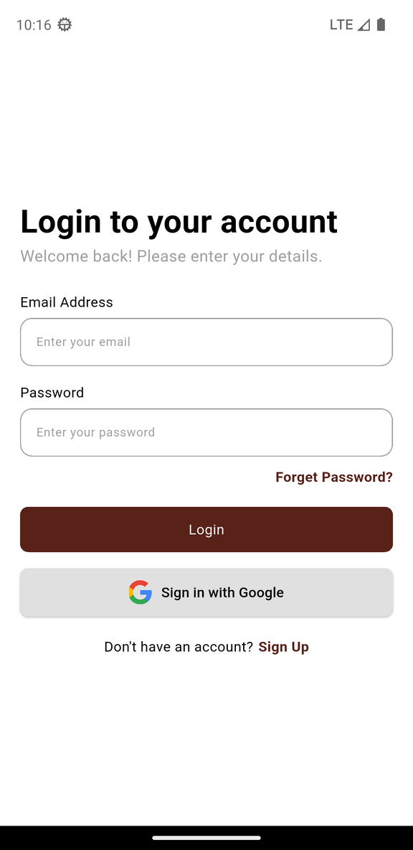
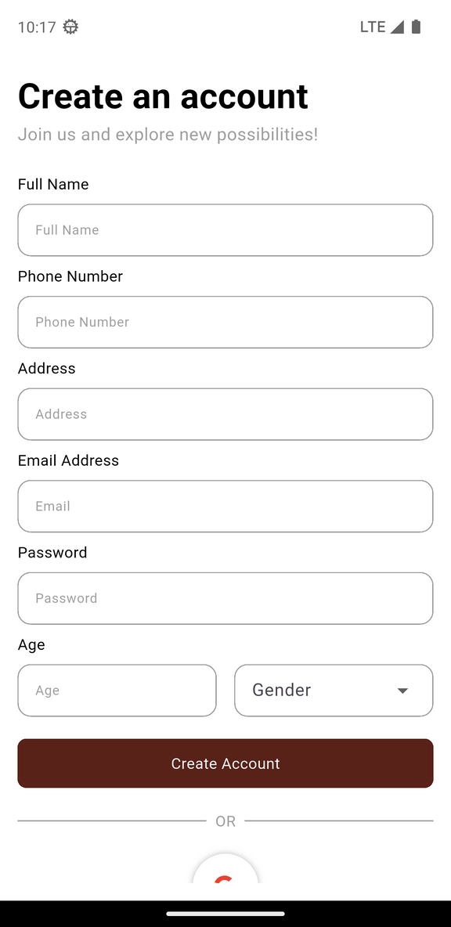
SYSTEM DESIGN
Splash Screen & Login:
Figure.15
44

Slide 45
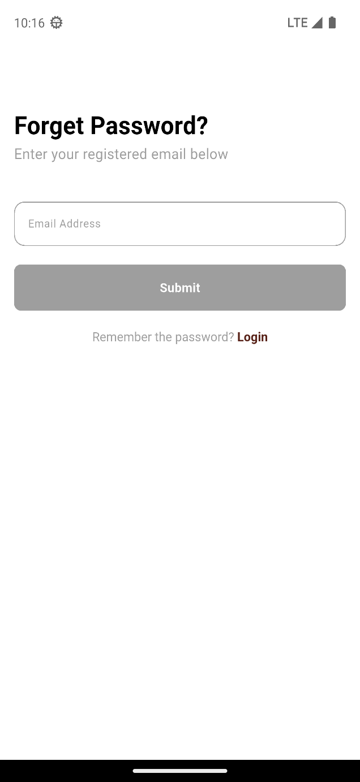
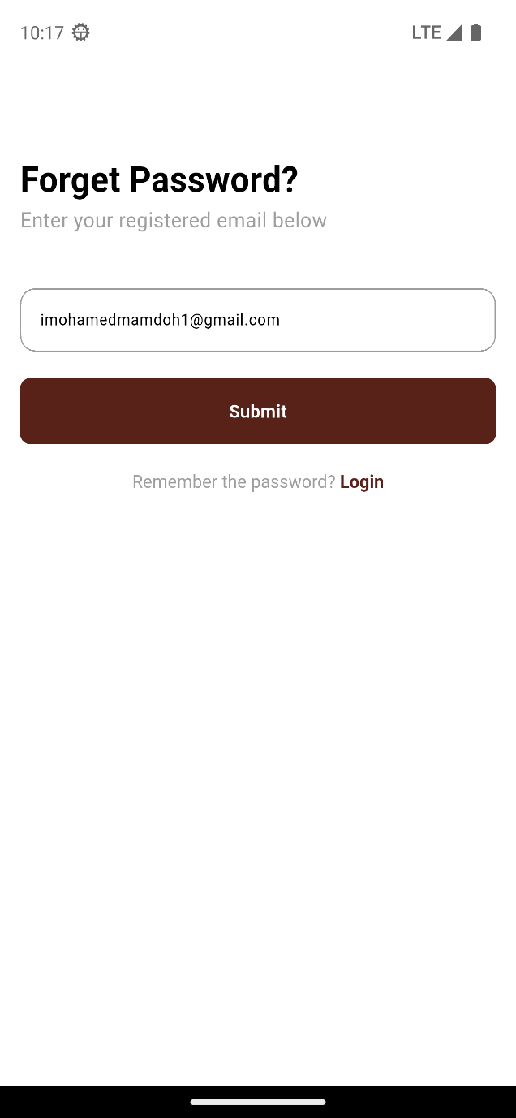
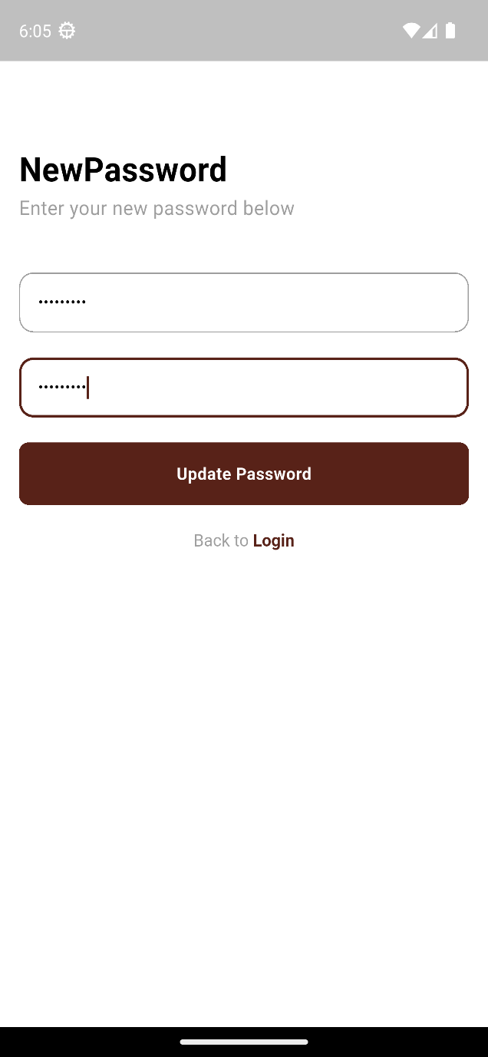
SYSTEM DESIGN
Forget Password:
Figure.16
45

Slide 46
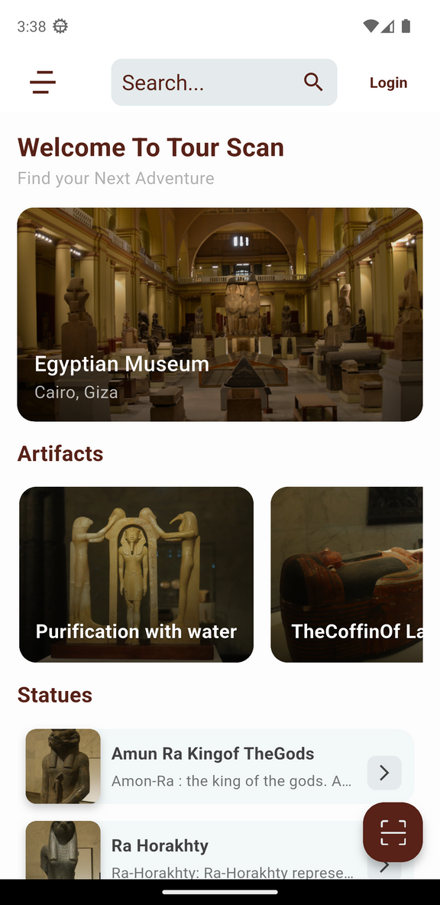
SYSTEM DESIGN
Home Screen:
The home screen displays featured museum artifacts and statues, with a floating action button for accessing the scanning feature. The navigation drawer provides access to settings, chat, and other sections of the application.
1.A customized app bar with search functionality
2.A navigation drawer for app-wide navigation
3.Lists of artifacts and statues
4.A floating action button for statue scanning
Figure.17
46

Slide 47


SYSTEM DESIGN
Statue Recognition:
Image Selection: Users can capture a new image using the camera or select one from the gallery
Result Screen:
Upon successful recognition, Displays information in the user's selected language
Figure.18
Figure.19
47

Slide 48




SYSTEM DESIGN
Update Data:
Figure.20
48

Slide 49


SYSTEM DESIGN
Chatbot:
2.Send a message to the bot if you need any information, as it will respond real time.
Figure.21
Figure.22
49

Slide 50


SYSTEM DESIGN
Search & Details Screen:
1.Search for historical artifacts or Statues.
2.View detailed information about a selected item.
Figure.23
Figure.24
50

Slide 51
Demo
51

Slide 52

DEMO
52

Slide 53
Future work
53

Slide 54


Future work
1. Add ticket booking and guided tour scheduling features.
2. interactive maps with real-time GPS to locate artifacts and nearby cultural sites.
3. Multilingual Expansion
4. Expansion of the Artifact Database
54

Slide 55
Time Plan
55

Slide 56


Time Plan
Figure.25
56

Slide 57
Conclusions
57

Slide 58


Conclusions
This mobile application aims to enhance the tourism experience in Egypt by utilizing AI powered image recognition and Text Translation. By simply capturing an image of an artifact, users can instantly receive detailed historical information in their preferred language, making it easier for tourists to explore and appreciate Egypt’s rich heritag
58

Slide 59
References
59

Slide 60
References
https://colab.research.google.com/drive/1WGmfxmy_-8hc46kZ9pa47y4fSMfCdleH?usp=sharing
https://github.com/iMohamedMamdouh/TourScan_v2
https://www.tensorflow.org/recommenders
https://www.sciencedirect.com/science/article/pii/S1877050917321075?fr=RR-2&ref=pdf_download&rr=8d80e310fcd60e07
https://www.figma.com/design/ESSgjnvHyrX9gMQf82p1IN/Tourscan?node-id=6-2
https://www.sciencedirect.com/science/article/pii/S1877050917321075?fr=RR-2&ref=pdf_download&rr=8d80e310fcd60e07
60

Slide 61
Thank You
61

